Slide 1
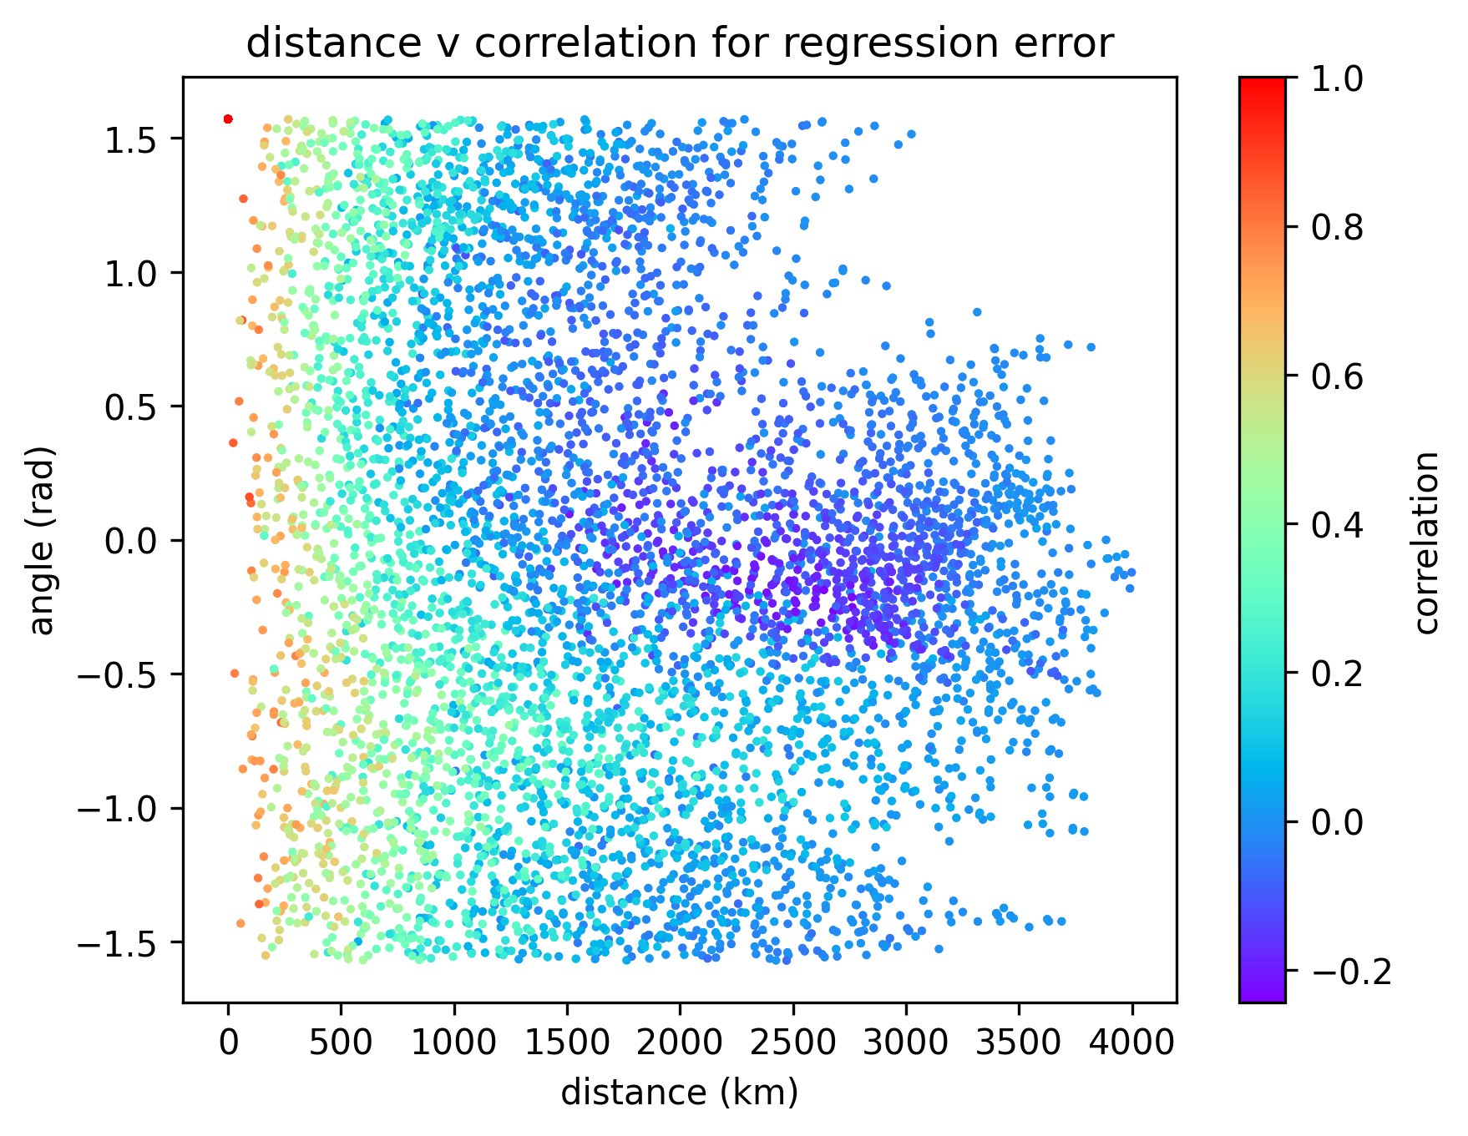
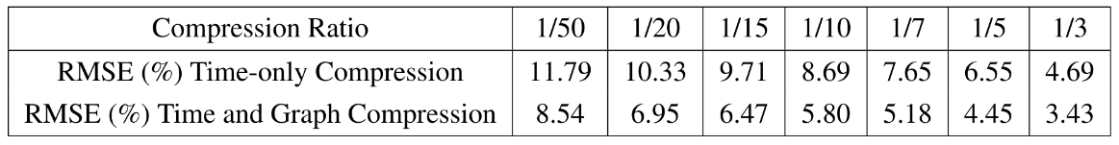
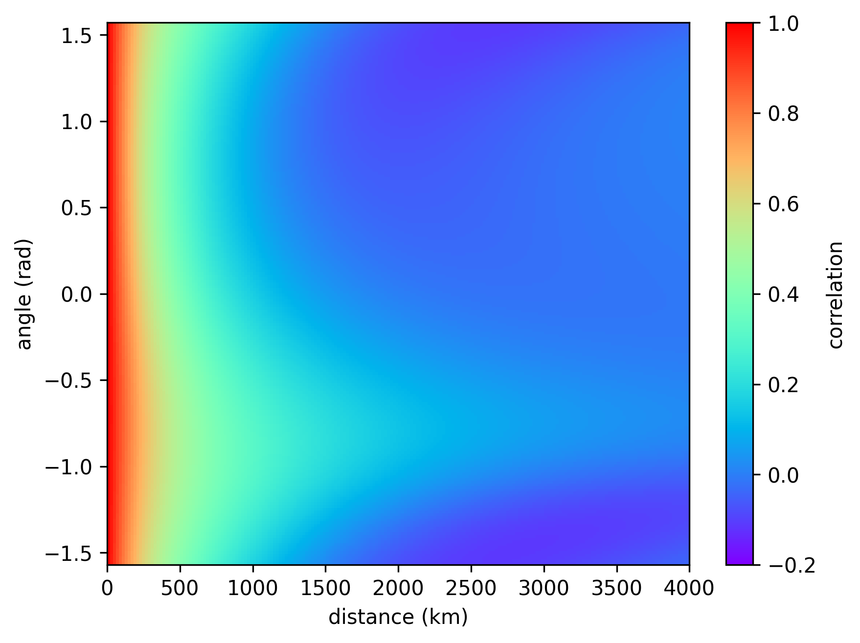
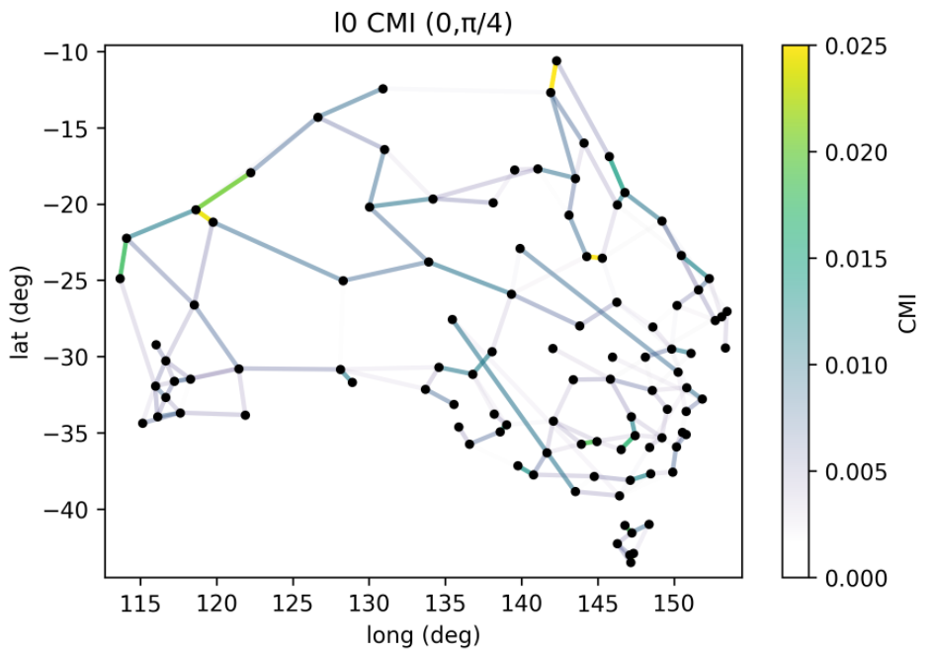

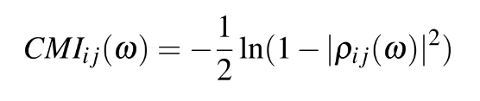
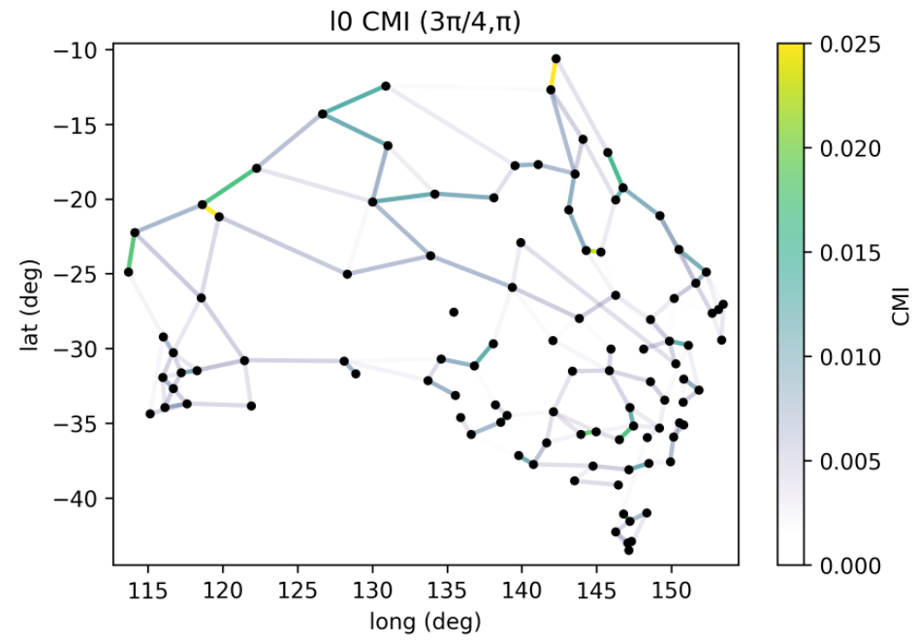
Thesis 2025
Graph Signal Processing
Zac Petersen
Supervisor: Prof. Victor Solo
Traditional Signal Processing to Graph Signal Processing
Fig. 2 Australian Temperature Sensor Signal Correlation vs Distance and Direction
Graph signal processing (GSP) extends traditional digital signal processing (DSP) to new domains, allowing users to port the myriad benefits of DSP across various problem types to less uniform domains. Benefits include data compression techniques for minimising storage costs, data cleaning using noise reduction techniques, smooth interpolation between discrete data points, and a variety of methods for predicting future data from past data.
GSP techniques have been used across many practical applications: The Google PageRank algorithm [1], spatial interpolation via Kriging [2]. and machine learning techniques like Graph Neural Networks used in drug discovery [3]. Despite this, GSP is not uniformly described or recognised by the signal processing and machine learning communities. Developing a uniform set of accessible descriptions and applications of GSP techniques serves to improve the recognition and furthering of GSP theory.
Fig. 1 Australian Daily Temperature Time and Graph-Domain Compression Improvement
Fig. 3 Correlation Function Fit Using Spatial Autoregressive Model
Parameter-Free Compression using Graph Fourier Transforms
A graph is a collection of vertices linked by edges. Graph data can be the graph itself, or the graph with values associated with either the vertices, edges, or both. Most data involves vertex-associated scalars. In traditional DSP, the Fourier transform is the transformation of data into the Eigenbasis of the time-shift operator, the Eigenvalues being roots of unity. In GSP, the graph defines an adjacency matrix A. We can diagonalise A=V⁻¹ΛV, yielding the graph Fourier transform (GFT), V⁻¹ [4].
Just as JPEG compression uses the discrete Fourier transform (DFT), we can use the GFT to compress data on a graph. Mean daily temperature data across 104 Australian temperature sensors was used as an example. For spatial data, with inverse-distance weighed edges, an efficient version of a compression algorithm due to Moura [5] was implemented, with results in Fig. 1. The algorithm developed addresses space complexity and time complexity constraints not addressed by Moura’s work.
Fig. 4 Bandpass Conditional Mutual Information Graph Identification
Complex Parameter Spatial Diffusion Modelling
In traditional DSP, one of the most common and important models is autoregression. One expects a priori that events can be in part predicted by events that came before. Similarly we expect temperatures to be similar at nearby points in space. The continuous, local form of this assumption can be expressed by the screened Poisson problem in Eqn. 1, driven by Gaussian white noise. From this we can derive a function predicting correlation from distance, achieving a 0.104 RMSE in correlation prediction.
Three modifications improve this fit. Multiple diffusion constants, an anisotropic linear transformation on the coordinates in the system, and allowing for complex parameters in the diffusion model. Complex parameters correspond with oscillatory systems, allowing for negative predictions of correlation. This fit in Fig. 3 is compared with the measured correlations for a distance-angle-correlation function in Fig. 2. The model uses 18 parameters, compared with just one, to improve the fit RMSE to 0.0746.
Eqn. 1 Noise-driven Screened Poisson Problem
Eqn. 2 Per-frequency Conditional Mutual Information
ℓ0-Regularised Data Prediction and Graph Identification
ℓ0 regularisation penalises a model by the number of parameters it has, encouraging simplicity and generalisation. It often makes otherwise easy-to-solve optimisation targets into harder, non-convex problems. Despite this, it performs well. Choosing the regularisation parameter to optimise the Bayesian Information Criterion (BIC), Australian mean daily temperature data at 104 sensor points can be predicted one day ahead with an RMSE of 1.66ºC using 3904 parameters.
The Conditional Mutual Information (CMI) measures information shared between signals, accounting for all other known signals. It aggregates across the per-frequency CMI, shown in Eqn. 2, which measures how the frequency content in one signal conditionally predicts the frequency content of the other signal. The graphs on the left demonstrate that by aggregating in a bandpass region rather than across the whole frequency range, we can effectively perform graph identification by selecting those relationships that predict either long-time (low frequency) content, or short-time (high frequency) content, as in the top and bottom plots of Fig. 4 respectively. Their similarity demonstrates that there is a reasonable expectation that if things are predictive of each other in the short term, they are often predictive of each other in the long term, and vice versa.
[1] Page L. The pagerank citation ranking: bringing order to the web. Stanford Digital Library Project, 1998.
[2] Krige D. A statistical approach to some basic mine valuation problems on the witwatersrand. Journal of the Chemical Metallurgical Mining Society of South Africa, 1951.
[3] Sun M., et. al. Graph neural networks: A review of methods and applications. AI Open, 2020.
[4] Stankovi´c L., et. al. Vertex-frequency graph signal processing: A comprehensive review. Elsevier, 2020.
[5] Moura J., Sandryhaila A. Big data analysis with signal processing on graphs. IEEE Signal Processing Magazine, pages 80–90, 2014.

